Slide 1
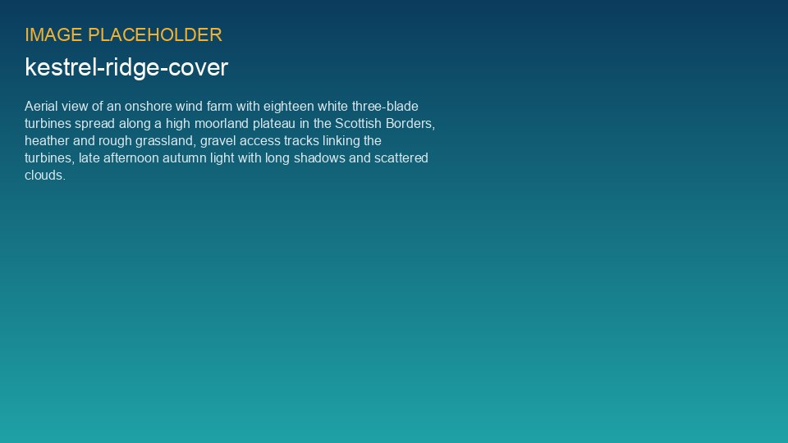
WEYLAND ENERGY
Kestrel Ridge – Annual Performance Review 2025
Asset Operations · February 2026

Slide 2
2025 at a glance
206.6 GWh
97.4 %
31.2 %
0
Net generation
Availability (target 97.0 %)
Capacity factor
Lost time injuries
• Generation -3.2 % vs. P50 – wind resource about 3 % below the long-term mean
• First full calendar year of operation
WEYLAND ENERGY · Kestrel Ridge – Annual Performance Review 2025
2
Notes:
Key message: the asset performs well; the shortfall vs. P50 is wind, not availability.

Slide 3
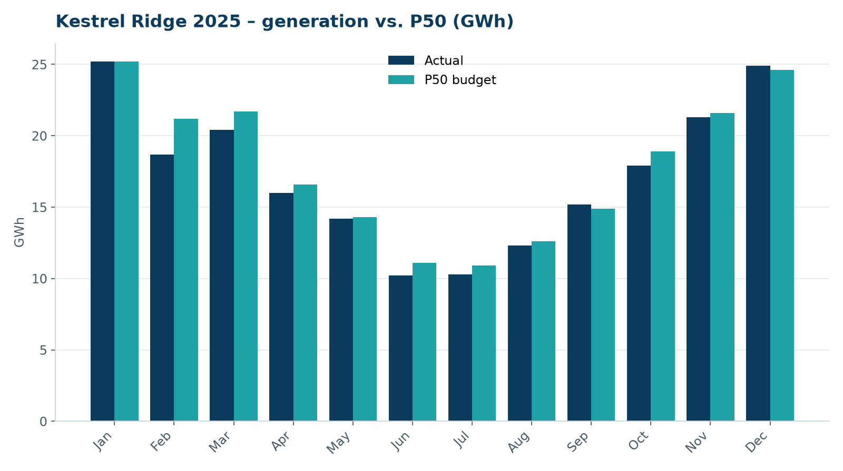
Generation vs. budget
• Strong January and December
• Weak February and June (low wind)
• Grid curtailment: 1.9 % of potential production
WEYLAND ENERGY · Kestrel Ridge – Annual Performance Review 2025
3

Slide 4
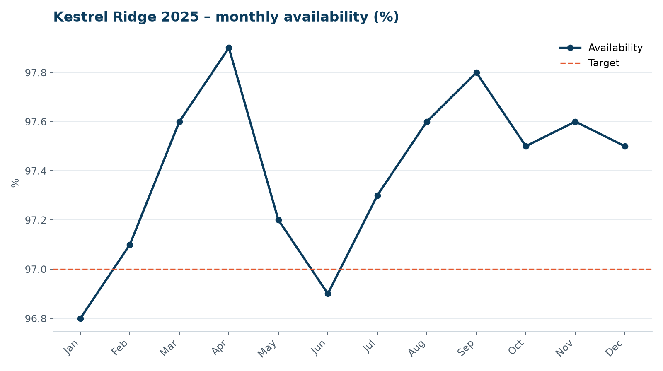
Availability
• Above the 97.0 % contract target in 10 of 12 months
• First annual service campaign May–September
• No major component exchange in 2025
WEYLAND ENERGY · Kestrel Ridge – Annual Performance Review 2025
4

Slide 5
Year-on-year
KPI | 2024 (Mar 15–Dec) | 2025
Generation (GWh) | 144.2 (Apr–Dec) | 206.6
Availability | 96.5 % | 97.4 %
Capacity factor | 28.9 % | 31.2 %
Corrective work orders | 312 | 248
Near misses reported | 9 | 14
WEYLAND ENERGY · Kestrel Ridge – Annual Performance Review 2025
5

Slide 6
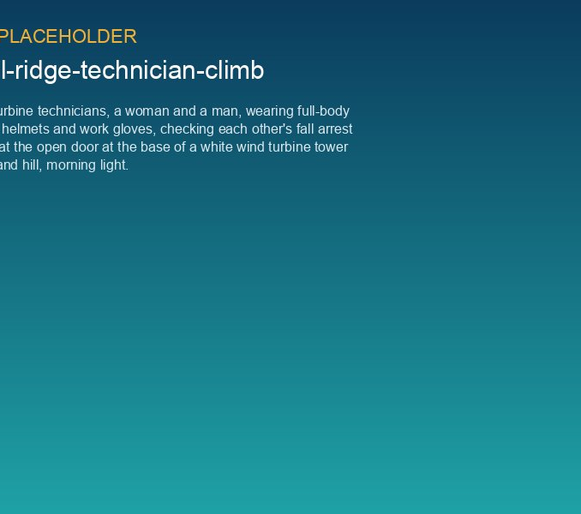
What went well
• Reliability of converters after the 2024 firmware fix
• Ice detection and automatic restart (21 of 27 restarts automatic)
• Good cooperation with landowners and no community complaints
• Bird carcass monitoring year 2 completed on schedule
WEYLAND ENERGY · Kestrel Ridge – Annual Performance Review 2025
6

Slide 7
What we need to improve
• Close corrective work orders faster (81 % within 14 days)
• Recurring pitch accumulator faults on T-05 and T-11
• Oil analysis follow-up: T-07 'watch' result in November not escalated
• Leading edge erosion on westerly turbines
WEYLAND ENERGY · Kestrel Ridge – Annual Performance Review 2025
7
Notes:
The T-07 point is important – see KR-INC-2026-003. The November oil sample was a missed early warning.

Slide 8
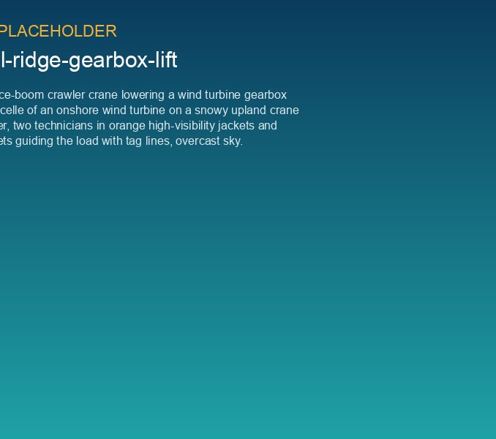
Early 2026: T-07 gearbox failure
• KR-INC-2026-003: ISS bearing failure on 14 January
• Gearbox exchanged under warranty, back online 6 February
• Lost production ~1,046 MWh
• Fleet endoscope campaign started
WEYLAND ENERGY · Kestrel Ridge – Annual Performance Review 2025
8

Slide 9
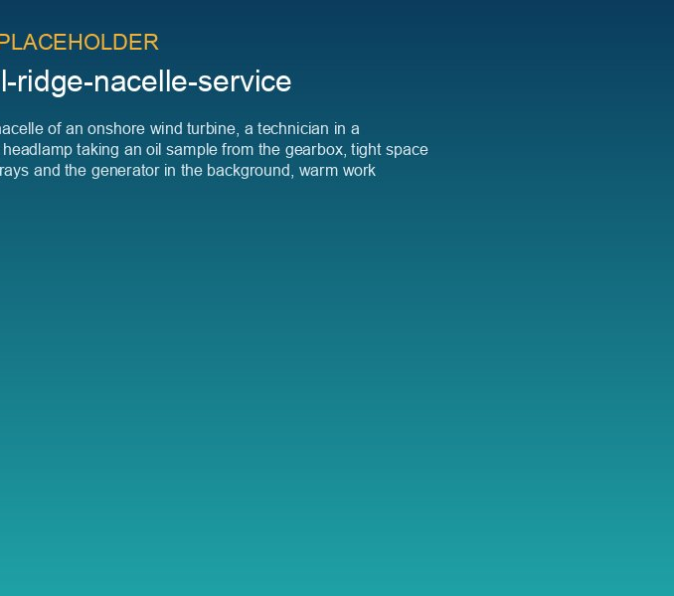
Priorities 2026
• Drive-train reliability: CMS thresholds, 3-monthly oil sampling
• Annual service campaign April–September (finish 3 weeks earlier)
• Blade inspection by drone, LEP repair plan for 2027
• SCADA cyber security hardening
WEYLAND ENERGY · Kestrel Ridge – Annual Performance Review 2025
9

Slide 10
WEYLAND ENERGY
Thank you
Questions: David Chen · Ben Okoye · Sara Lindgren

